Slide 1
Introduction to Design Patterns

Slide 2
Outline
Introduction
Design Patterns
Types of Design Patterns

Slide 3

Introduction
Software development is like putting together a puzzle.
Object-oriented programming is a popular way to build complex software, but it can be tricky when you face the same design problems repeatedly.

Slide 4

Introduction
Before software engineers do the actual software development, they conceptualize or create a plan on how the software system will work.
This process is called Software design.

Slide 5
Introduction
Software design involves problem solving and planning to give a proposed solution to a specific problem.

Slide 6
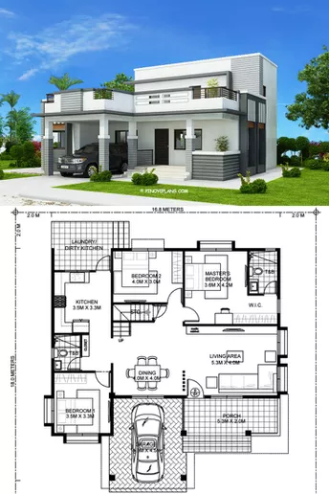
Introduction
A software design model can be compared to plan when building a house.

Slide 7
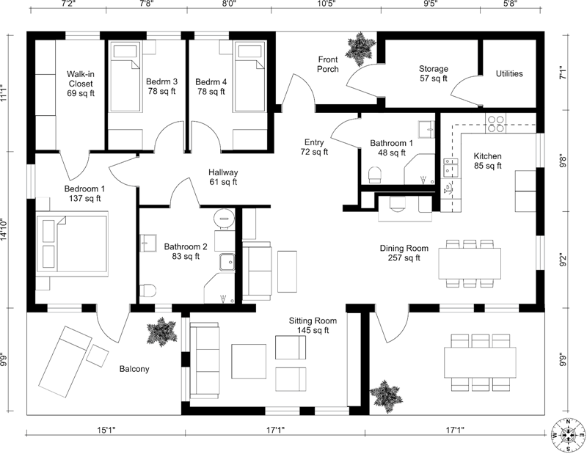
Introduction
High-level plans represent the totality of the house (e.g., drawing of the house).

Slide 8
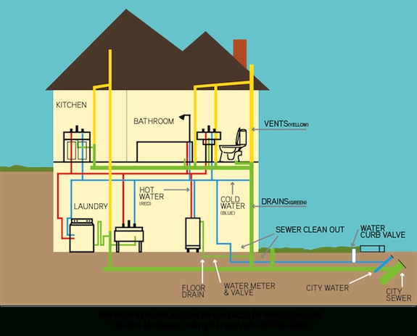
Introduction
Low-level plans provide guidance for constructing each detail (e.g., plumbing).

Slide 9


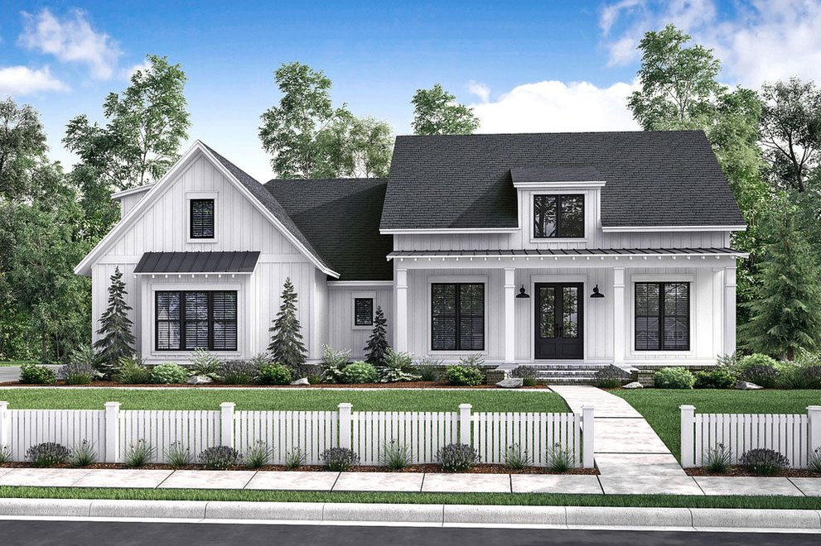
Introduction
However, designing a house is very different from designing a software. House architecture is typically linear.
Plan
Build
Done

Slide 10
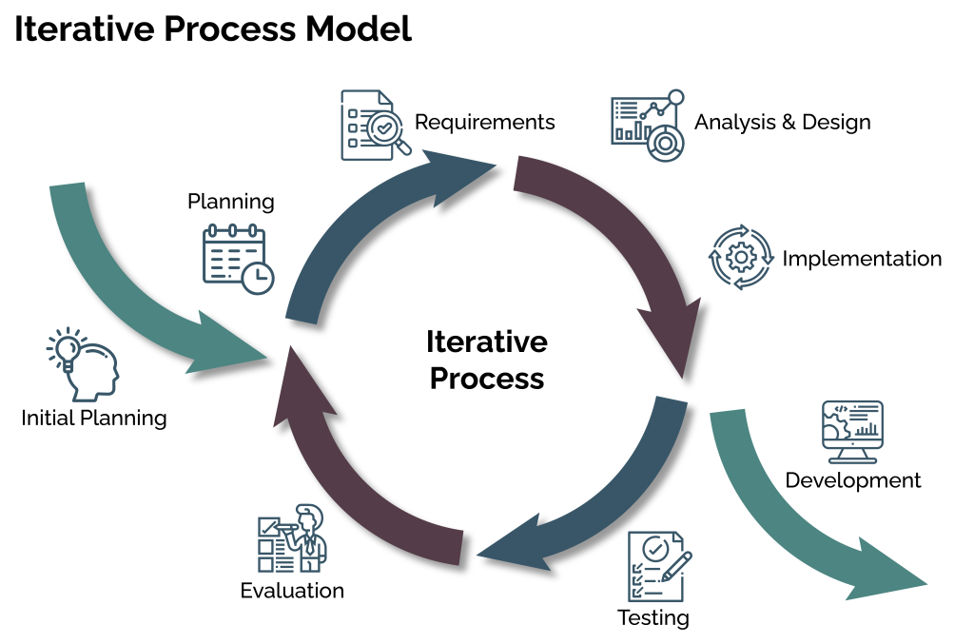
Introduction
Designing software is iterative.
Software is soft because it is meant to change often.
Design can evolve during and after deployment and it must accommodate changing requirements, users and technology.

Slide 11
Introduction

Slide 12
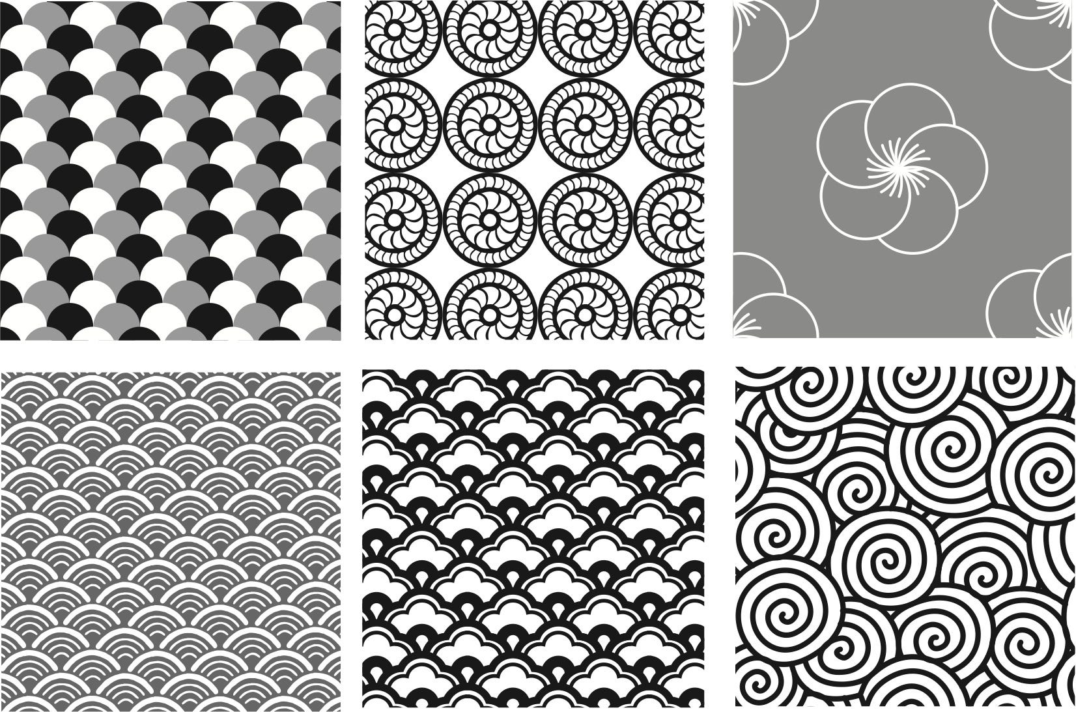
Design patterns
A software designer may identify a design aspect which has been visited and perhaps even solved by others in the past.
A template or pattern describing a solution to a common problem is known as a design pattern.

Slide 13
What are Design patterns?
Design patterns are typical solutions to commonly occurring problems in software design.
They are like pre-made blueprints that you can customize to solve a recurring design problem in your code.

Slide 14
What are Design patterns?
You can’t just find a pattern and copy it into your program, the way you can with off-the-shelf functions or libraries.

Slide 15
What are Design patterns?
A design pattern is not a specific piece of code, but a general concept for solving a particular problem.
You can follow the pattern details and implement a solution that suits the realities of your own program.

Slide 16
Design Pattern vs Algorithms
Patterns are often confused with algorithms, because both concepts describe typical solutions to some known problems.
.

Slide 17
Design Pattern vs Algorithms
While an algorithm always defines a clear set of actions that can achieve some goal, a pattern is a more high-level description of a solution.
The code of the same pattern applied to two different programs may be different.

Slide 18
Design Pattern vs Algorithms
Algorithms focus in how to do something
while..
Design patterns focus on how to structure the code

Slide 19
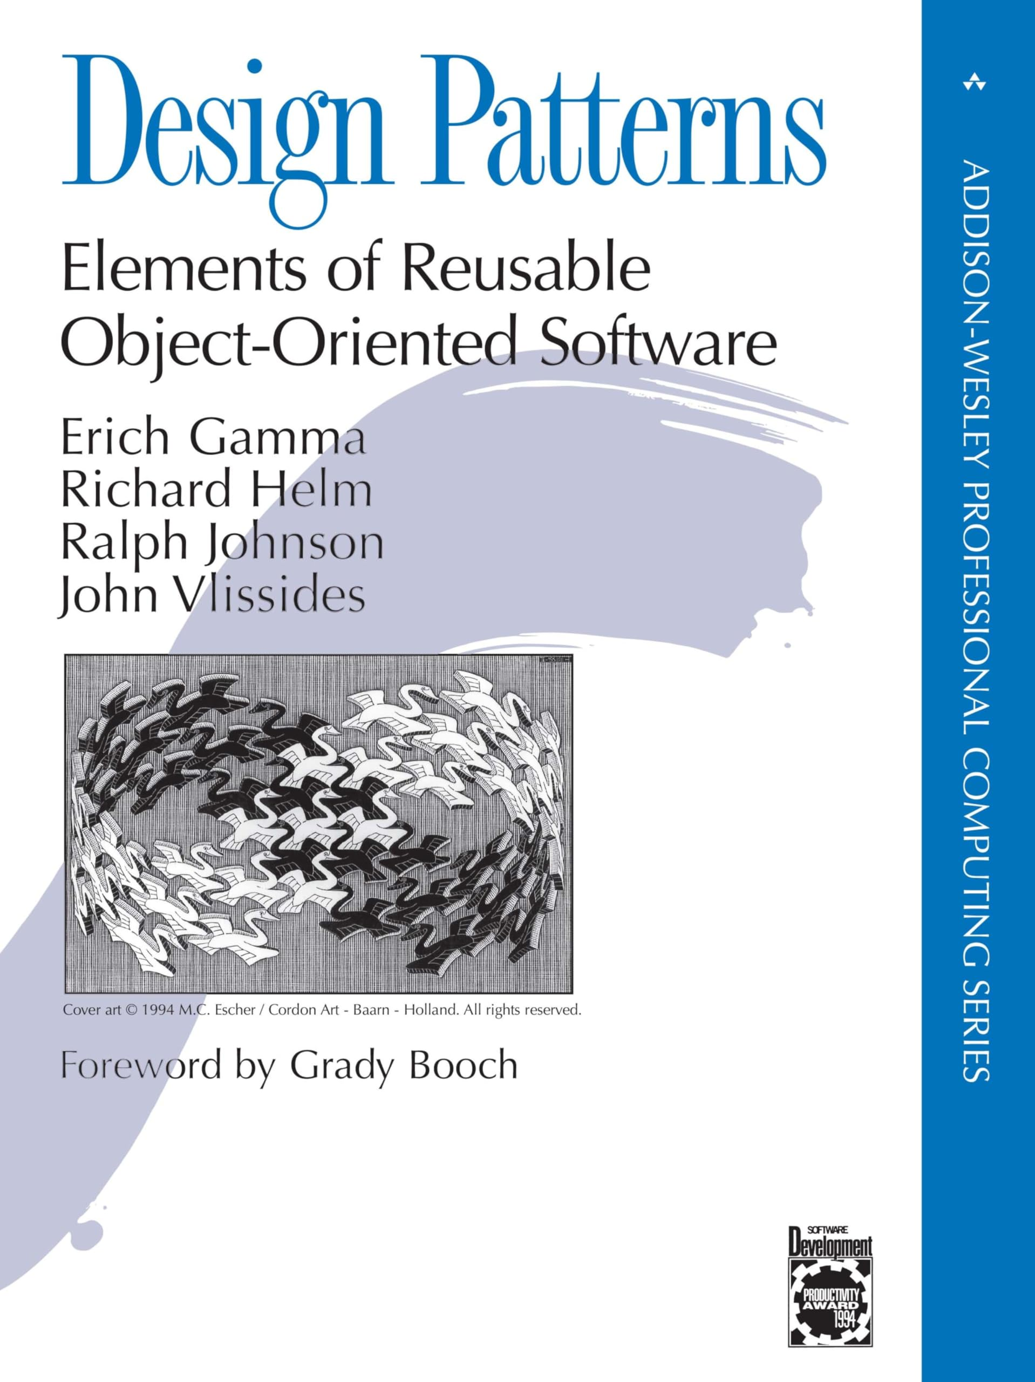
Who invented design patterns?
When a solution gets repeated over and over in various projects, someone eventually puts a name to it.

Slide 20
Who invented design patterns?
The idea was picked up by four authors: Erich Gamma, John Vlissides, Ralph Johnson, and Richard Helm.

Slide 21
Who invented design patterns?
In 1995, they published Design Patterns: Elements of Reusable Object-Oriented Software, in which they applied the concept of design patterns to programming.

Slide 22
Who invented design patterns?
The book featured 23 patterns solving various problems of object-oriented design and became a bestseller very quickly.

Slide 23
Who invented design patterns?
Since then, dozens of other object-oriented patterns have been discovered.
The “pattern approach” became very popular in other programming fields, so lots of other patterns now exist outside of object-oriented design as well.

Slide 24

Why should I learn design patterns?
The truth is that you might manage to work as a programmer for many years without knowing about a single pattern.

Slide 25

Why should I learn design patterns?
A lot of people do just that. Even in that case, though, you might be implementing some patterns without even knowing it.
So why would you spend time learning them?

Slide 26
Why should I learn design patterns?
Design patterns are a toolkit of tried and tested solutions to common problems in software design.

Slide 27

Why should I learn design patterns?
Even if you never encounter these problems, knowing patterns is still useful because it teaches you how to solve all sorts of problems using principles of object-oriented design.

Slide 28

Why should I learn design patterns?
Design patterns define a common language that you and your teammates can use to communicate more efficiently.

Slide 29
Why should I learn design patterns?
You can say, “Oh, just use a Singleton for that,” and everyone will understand the idea behind your suggestion.
There is no need to explain what a singleton is if you know the pattern and its name

Slide 30
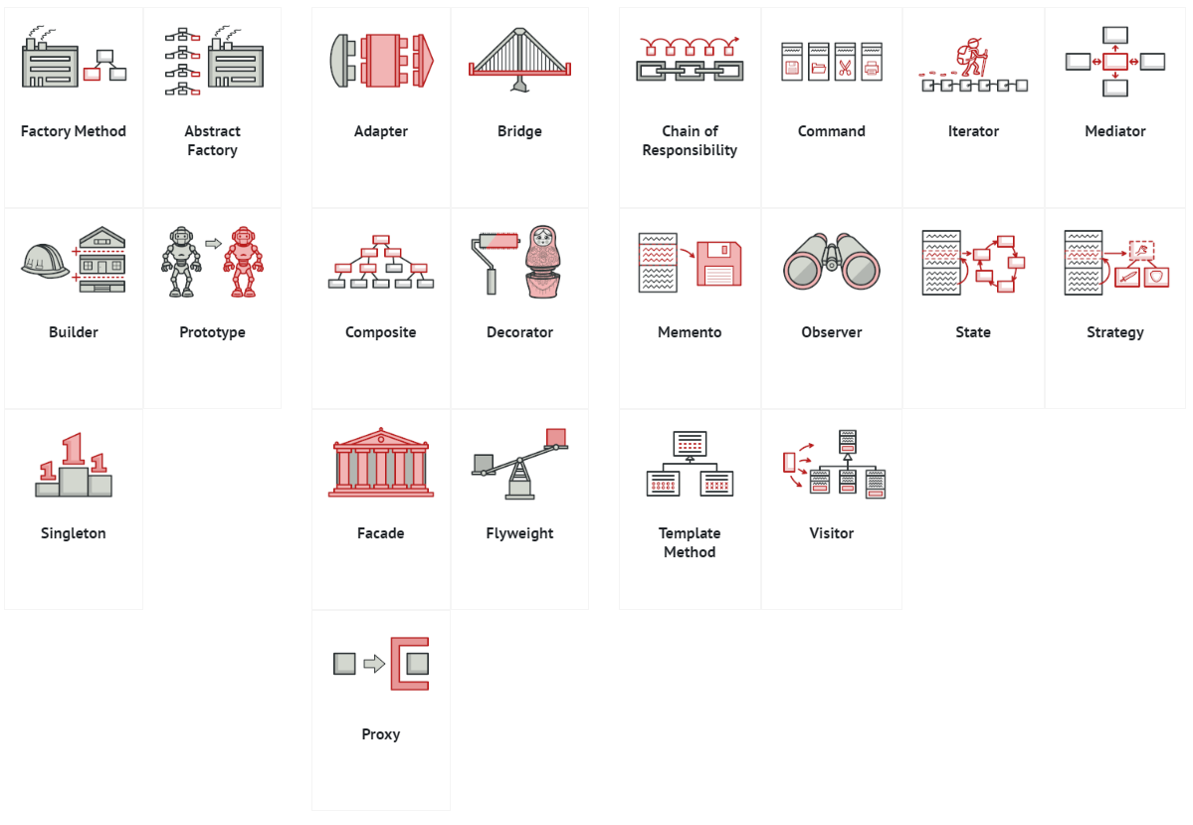
Types of Design patterns
Creational Patterns
Structural Patterns
Behavioral Patterns

Slide 31
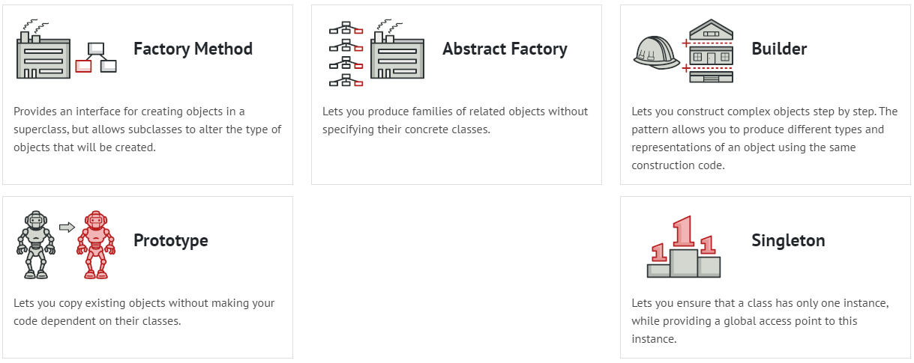
Creational Design Pattern
Creational design patterns provide various object creation mechanisms, which increase flexibility and reuse of existing code.

Slide 32
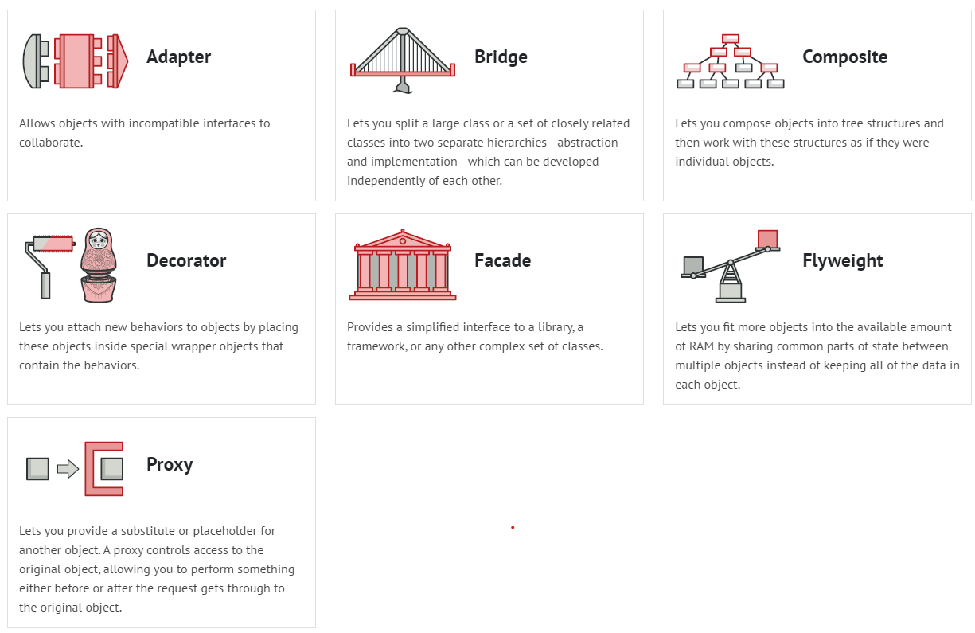
Structural Design Pattern
Structural design patterns explain how to assemble objects and classes into larger structures, while keeping these structures flexible and efficient.

Slide 33
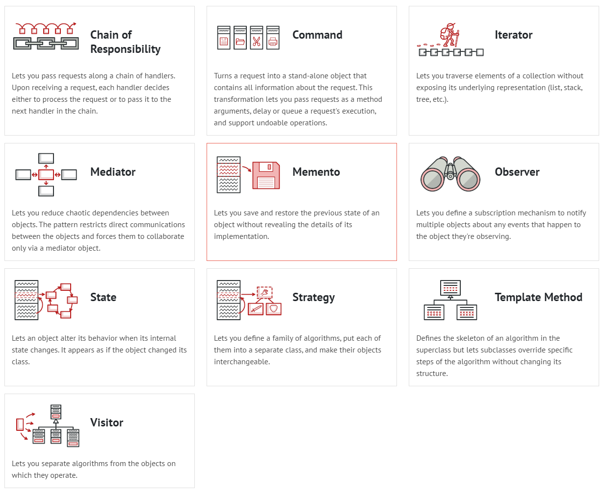
Behavioral Design Pattern
Behavioral design patterns are concerned with algorithms and the assignment of responsibilities between objects.

Slide 34
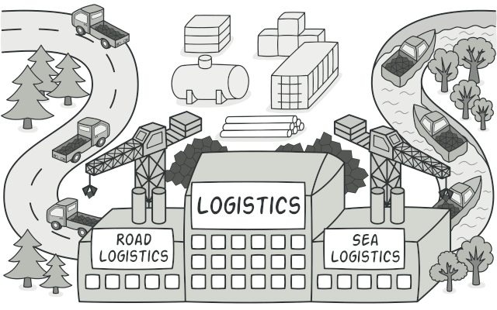
Factory Method
Factory Method is a creational design pattern that provides an interface for creating objects in a superclass, but allows subclasses to alter the type of objects that will be created.

Slide 35
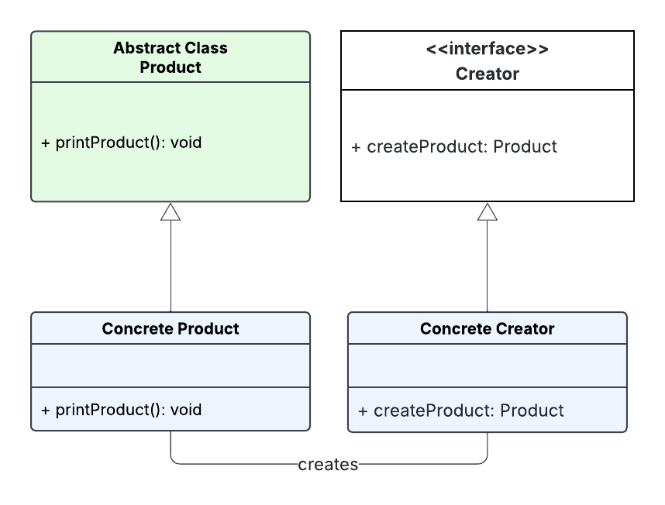




Components of a Factory Method
1. The Creator is an abstract class or an interface that declares the factory method.
The creator typically contains a method that serves as a factory for creating objects. It may also contain other methods that work with the created objects.

Slide 36
Components of a Factory Method
Concrete Creator classes are subclasses of the Creator that implement the factory method to create specific types of objects. Each Concrete Creator is responsible for creating a particular product.

Slide 37
Components of a Factory Method
3. The Product is the interface or abstract class for the objects that the factory method creates.
The Product defines the common interface for all objects that the factory method can create.

Slide 38
Components of a Factory Method
4. Concrete Product classes are the actual objects that the factory method creates.
Each Concrete Product class implements the Product interface or extends the Product abstract class.

Slide 39
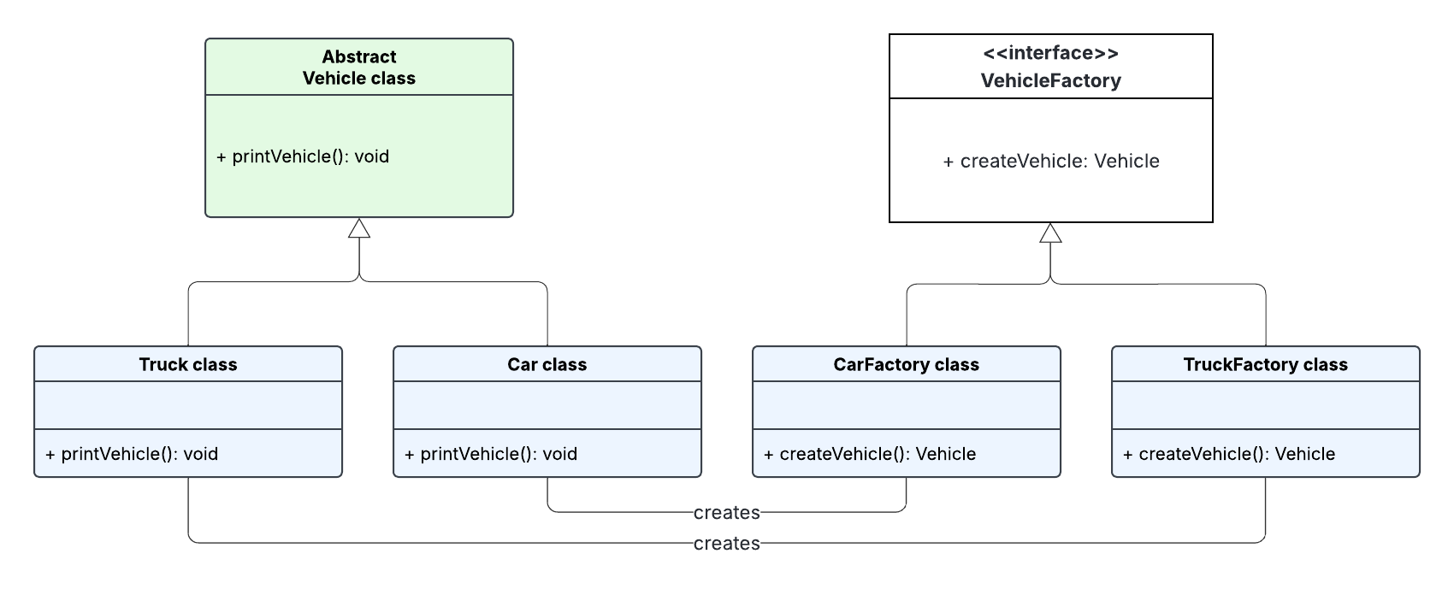
Factory Method Class Diagram

Slide 40
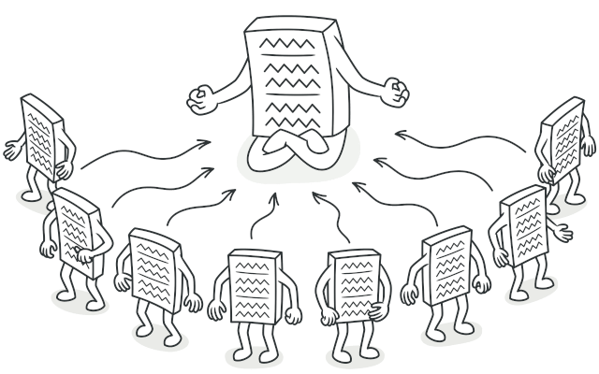
Singleton
Singleton is a creational design pattern that lets you ensure that a class has only one instance, while providing a global access point to this instance.

Slide 41
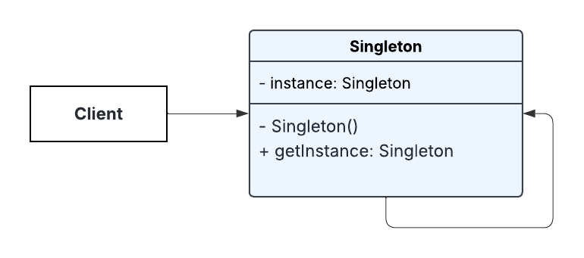
Singleton
To create a singleton class, we must first create a private constructor to prevent creating a Singleton Object.
By making the Singleton’s constructor private, it makes it hidden from the client.

Slide 42
Singleton
Next, create the static method called getInstance() which returns the single instance of the class. Calling the getInstance() method should be the only way of creating a Singleton object.

Slide 43
Singleton
Then store the instance in the private static variable which ensures that only one Singleton object is created.

Slide 44
When to use Singleton?
Use the Singleton pattern when a class in your program should have just a single instance available to all clients; for example, a single database object shared by different parts of the program.
Use the Singleton pattern when you need stricter control over global variables.

Slide 45
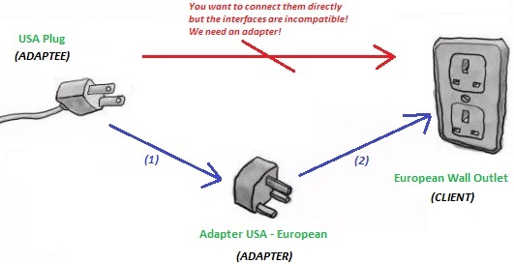
Adapter
Adapter is a structural design pattern that allows objects with incompatible interfaces to collaborate

Slide 46
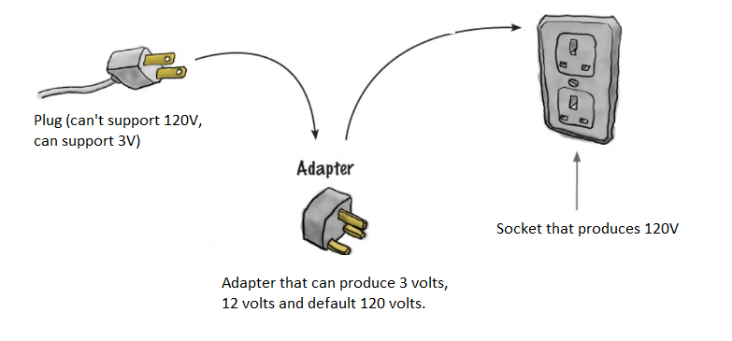
Adapter

Slide 47
Adapter
Adaptee
Client
You want to connect them directly but the interfaces are incompatible. We need an adapter!

Slide 48
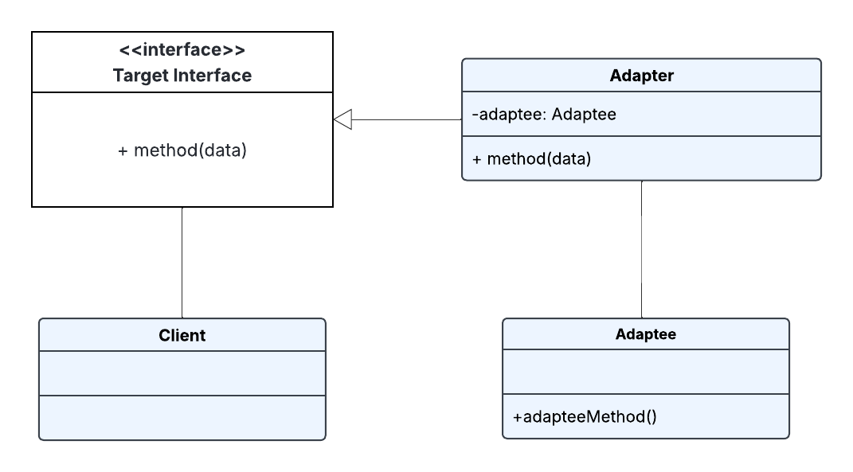
Components of Adapter
1. The target interface defines the interface expected by the client.
It represents the set of operations that the client code can use. It’s the common interface that the client code interacts with.

Slide 49
Components of Adapter
2. The adaptee is the existing class or system with an incompatible interface that needs to be integrated into the new system.
It’s the class or system that the client code cannot directly use due to interface mismatches.

Slide 50
Components of Adapter
3. The adapter is class that implements the target interface and internally uses an instance of the adaptee to make it compatible with the target interface.
It acts as a bridge, adapting the interface of the adaptee to match the target interface.

Slide 51
Components of Adapter
4. The client is the code that uses the target interface to interact with objects. It remains unaware of the specific implementation details of the adaptee and the adapter.

Slide 52
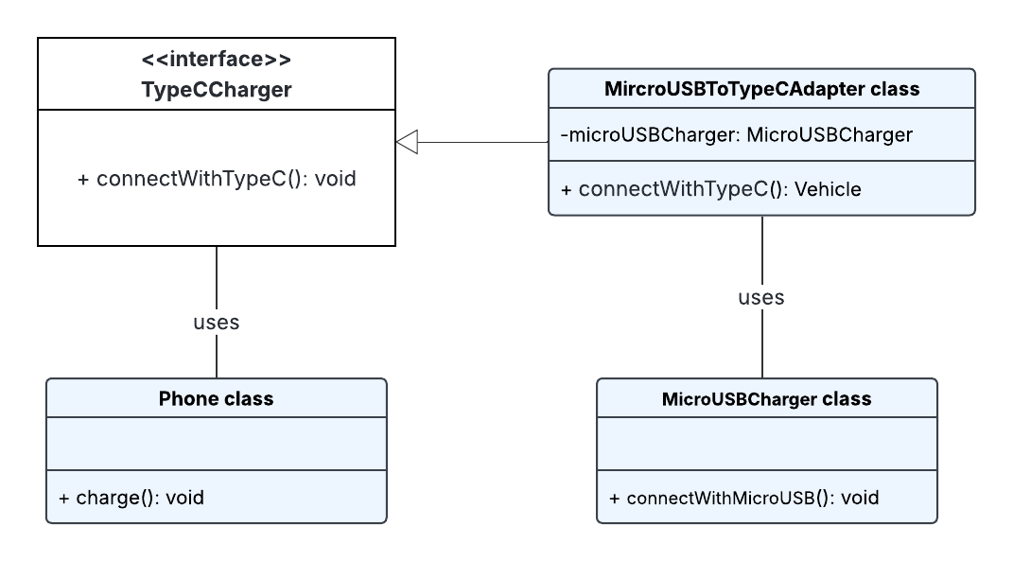
Adapter Class Diagram

Slide 53
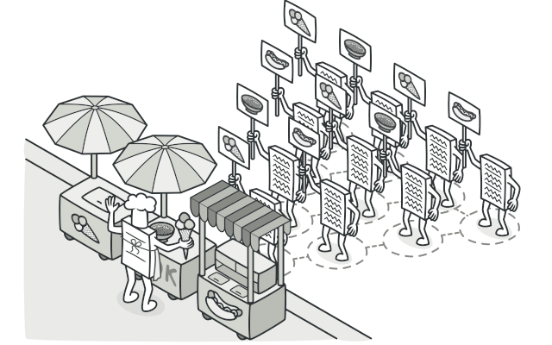
Visitor
Visitor is a behavioral design pattern that lets you separate algorithms from the objects on which they operate.

Slide 54
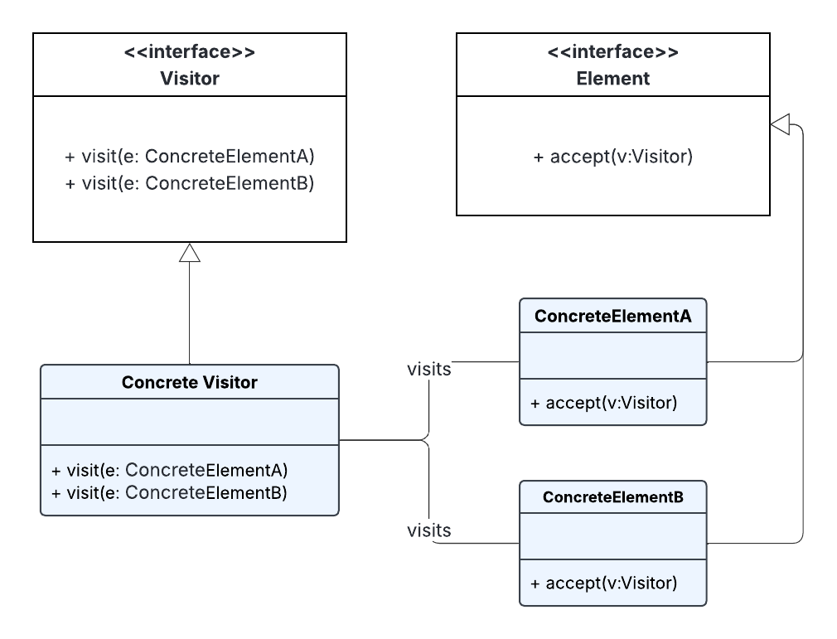
Components of Visitor Pattern
1. Visitor Interface. This interface declares a visit method for each type of element in the object structure.
Each method is designed to handle a specific element type.

Slide 55
Components of Visitor Pattern
2. Concrete Visitor. This class implements the Visitor interface and provides the specific behavior for each visit method.
It contains the logic for the operations that need to be performed on the elements.

Slide 56
Components of Visitor Pattern
3. Element Interface. This interface defines an accept method that takes a visitor as an argument.
This method allows the visitor to visit the concrete elements.

Slide 57
Components of Visitor Pattern
4. Concrete Elements These classes implement the Element interface and represent the various types of objects in the structure. Each concrete element defines how it accepts a visitor by calling the corresponding method on the visitor.

Slide 58
Summary
Creational patterns provide object creation mechanisms that increase flexibility and reuse of existing code.
Structural patterns explain how to assemble objects and classes into larger structures, while keeping the structures flexible and efficient.
Behavioral patterns take care of effective communication and the assignment of responsibilities between objects

Slide 59
References
https://refactoring.guru/design-patterns

